Slide 1
Embedded System Hacking and Security
ENPM809I - Spring 2020
Project By -
Manoj Kumar Korrapati
Milind Purswani
Ryan Quarry
Shrikara Belupu

Slide 2
Project objective
This project will seek to explore a development environment for hardware platforms called LabVIEW.
With this project our team seeks to analyze the files, libraries and scripts deployed by the LabVIEW environment on the BeagleBone Black, thus assessing the security flaws that can be exploited.

Slide 3
Table of Contents
Overview
Installation-Development-Deployment-Execution Using LINX
Issues with LabVIEW and LINX
LINX Functionality
Remote I/O
Local I/O - Interactive Mode
Local I/O - Startup Executable
Installation of LabVIEW on BBB
Variations of root
Scanning for Vulnerabilities
Security Flaw in BeagleBone Black
Vulnerabilities in LabVIEW installed Files
Discover Presence of BBB on a Network
Mitigation Strategies

Slide 4
Overview
LabVIEW
LabVIEW is, “systems engineering software for applications that require test, measurement, and control with rapid access to hardware and data insights” [2]. Software licenses are available to students through the University of Maryland Terpware program.
LINX
LINX is used for creating a hardware abstraction layer in which a single LabVIEW interface can be used for different types of hardware devices such as the Raspberry Pi or BeagleBone platforms. LINX acts as an intermediary bridge between hardware device and LabVIEW and aids in development, deployment, execution and communication between the two ends.

Slide 5
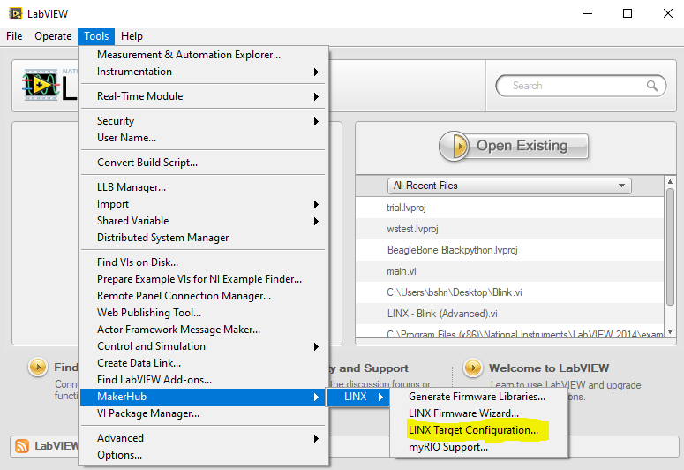
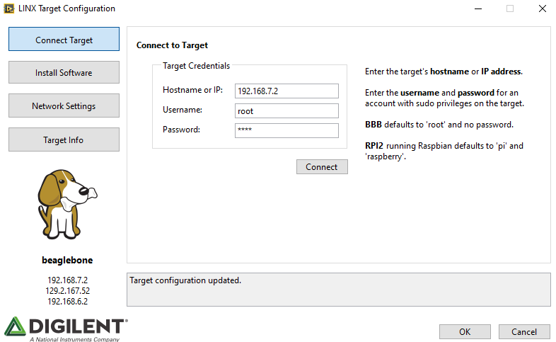
Installation-Development-Deployment-Execution
Using LINX

Slide 6
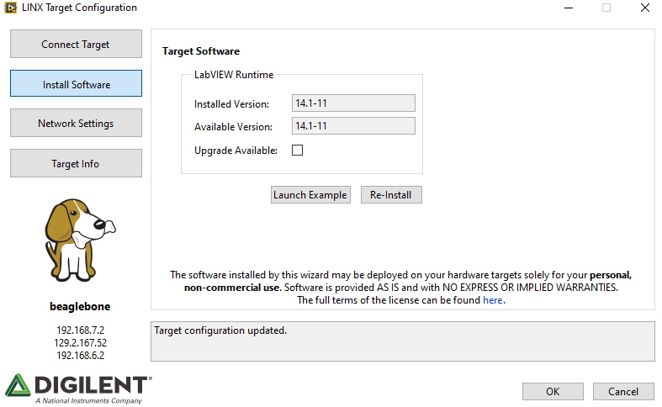
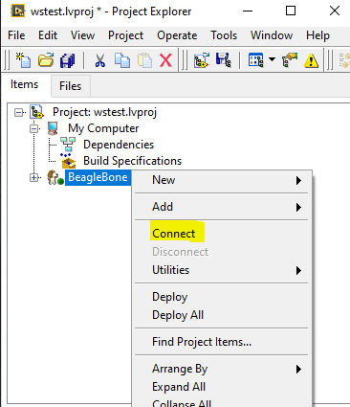
Installation-Development-Deployment-Execution
Using LINX(cont.)

Slide 7
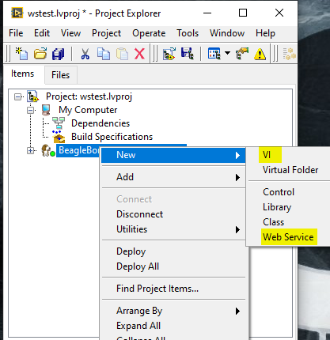
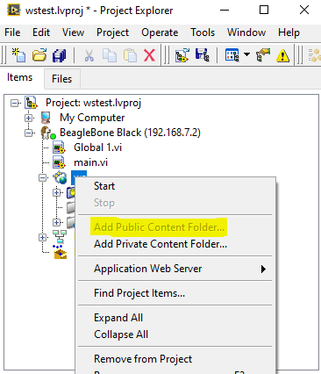
Installation-Development-Deployment-Execution
Using LINX(cont.)

Slide 8

Installation-Development-Deployment-Execution
Using LINX(cont.)
Link: https://drive.google.com/open?id=1_3iRBa7qjf3XXUmc_ATjCPCYsjDWB7DT
Example Source: https://www.labviewmakerhub.com/doku.php?id=learn:tutorials:libraries:linx:3-0:web-services

Slide 9
Issues with LabVIEW and LINX
No update for LINX since 2014.
Installation of LINX in LabVIEW does not deploy some dependency files in proper path.
Only 30% success rate during deployment of project to the BBB.
Web Services to be deployed using LabVIEW can only be of few file formats like HTML, CSS, and Javascript. Does not support server side languages such as php.
Extensive Web Service cannot be built because of unavailability of DB connectivity.

Slide 10

LINX Functionality
LINX is used for creating a hardware abstraction layer in which a single LabVIEW interface can be used for different types of hardware devices such as the Raspberry Pi or BeagleBone platforms.
There are two different types of mechanisms used by LINX to gain access to the hardware device -
Remote I/O
Local I/O

Slide 11
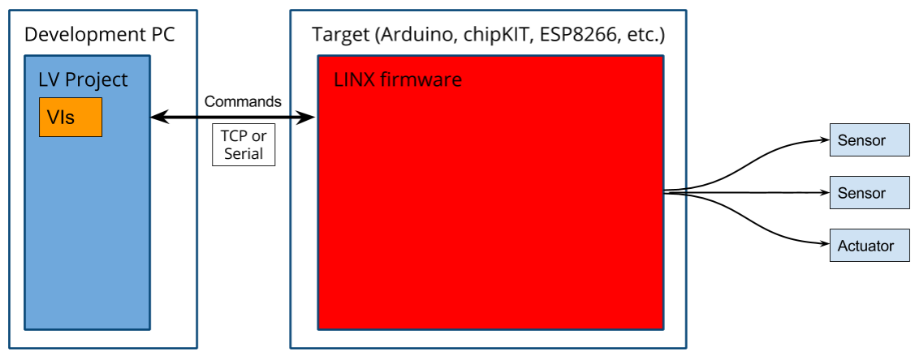
Remote I/O
Source: https://labviewhacker.com/doku.php?id=learn:libraries:linx:misc:linx-internals

Slide 12
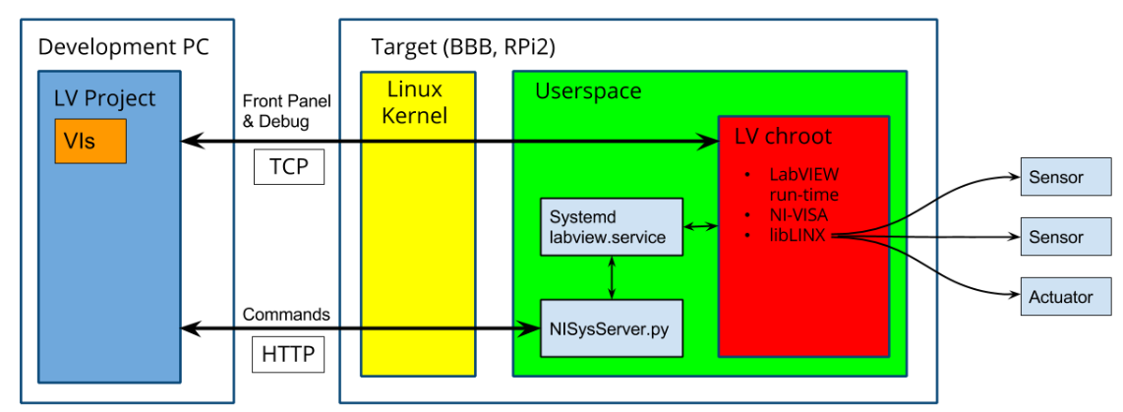
Local I/O - Interactive Mode
Source: https://labviewhacker.com/doku.php?id=learn:libraries:linx:misc:linx-internals

Slide 13
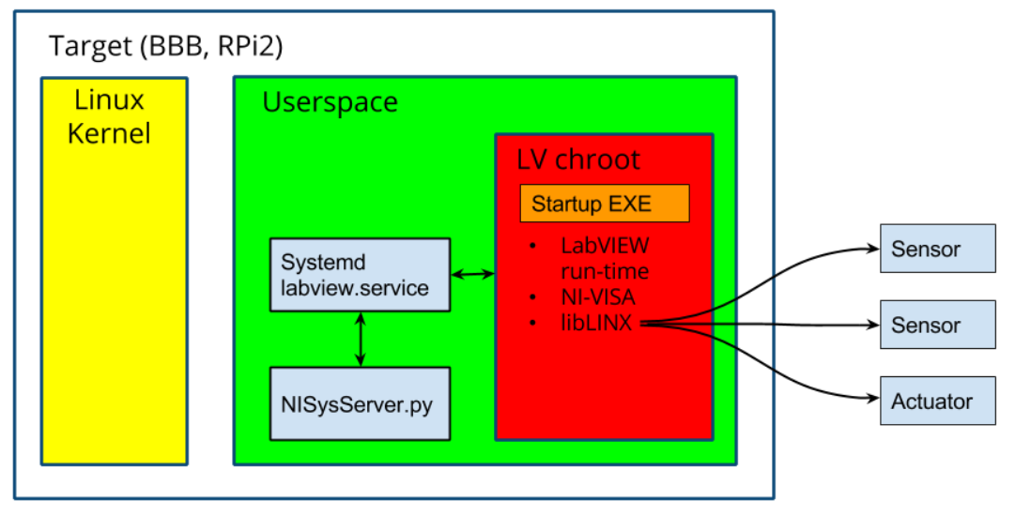
Local I/O - Startup Executable
Source: https://labviewhacker.com/doku.php?id=learn:libraries:linx:misc:linx-internals

Slide 14
Installation of LabVIEW on BBB
Deductions based on the Installation
Methods of installation -
Using LabVIEW GUI
Manual Installation by downloading .deb file on BBB
Source:https://www.labviewmakerhub.com/doku.php?id=learn:libraries:linx:misc:target-manual-install
The initial setup of LINX on Linux based boards occurs via a debian package named “lvrt-schroot”.
The LabVIEW run-time is controlled by a systemd service, “labview.service”, and is responsible for starting starting the LabVIEW chroot environment of the target device.
The utility server script written in python, NISysServer.py, is installed outside the chroot to remote restart the LabVIEW run-time using the HTTP protocol.
VIs executed on the target device get access to LINX firmware from a Linux shared object file liblinxdevice.so located inside chroot. This shared object file provides the logic required to access the I/O of the target board.

Slide 15
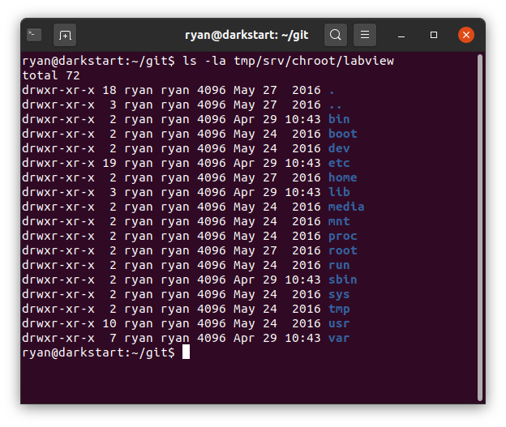
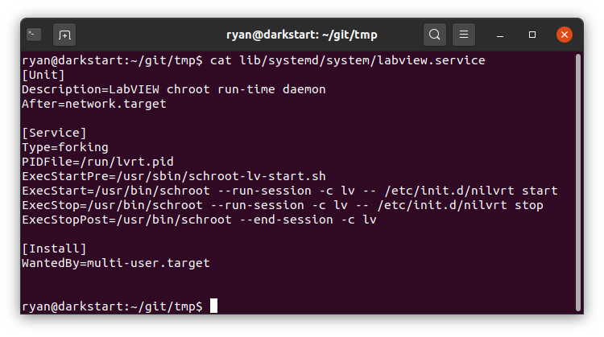
Variations of root
The chroot environment: A method of encapsulating binaries and their runtime libraries into a seperate folder tree which the resulting processes recognizes at its “/” folder tree.

Slide 16
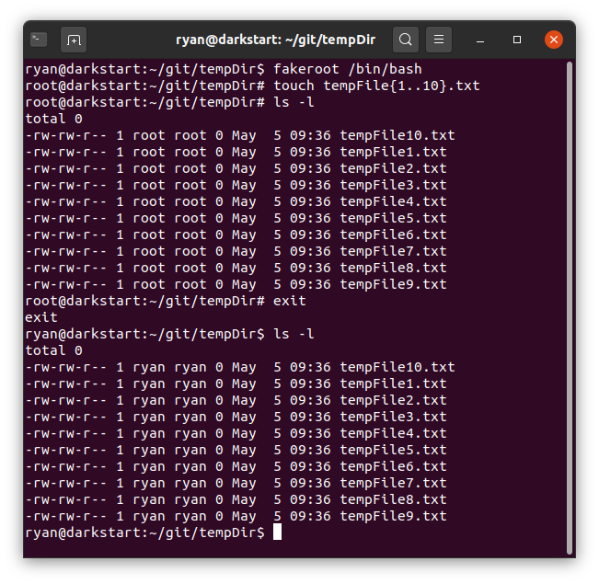
Variations of root
Fakeroot environment: runs a command in an environment where it appears to have root privileges for file manipulation. Useful for allowing users to create archives (tar, ar, .deb etc.) with files in them with root permissions/ownership. Without fakeroot one needs to have root privileges to create files in archives with the correct permissions and ownership, and then pack them up.
Source: https://www.commandlinux.com/man-page/man1/fakeroot.1.html

Slide 17

Scanning for Vulnerabilities....
Based on one our understanding about the working of LINX and problems with LabVIEW we started to find security flaws in BBB and following are our findings -
Usernames in BBB can be enumerated over SSH
Cloud9 Authentication and Authorization Misconfiguration
On checking the files and libraries installed by LabVIEW on our BBB, we found-
NISysServer.py is a script written in Python2 and this script is executed every time the BBB is booted up. So we figured out ways this file can make the machine vulnerable -
Creating unavailability of target machine with help of a function call made in the script.
Creating backdoor with malicious lvrt-schroot Debian package.

Slide 18
Security Flaws in BeagleBone Black
USER ENUMERATION
BBB currently have a SSH service (OpenSSH 6.7p1) running on port 22 which is vulnerable to CVE 2018-15473.OpenSSH versions prior to 7.7 are vulnerable to this attack.
Attack Techniques
Brute Force Attack
Dictionary Attack
For an invalid input, userauth_pubkey() function returns SSH2_MSG_USERAUTH_FAILURE message immediately without taking any time. But for a valid input , userauth_pubkey() calls fatal() function which exits the process and closes the connection to the client.
False Positives:
OpenSSH server will refuse connections due to high number of SSH requests.
This is similar to the response when a valid user input is provided.

Slide 19
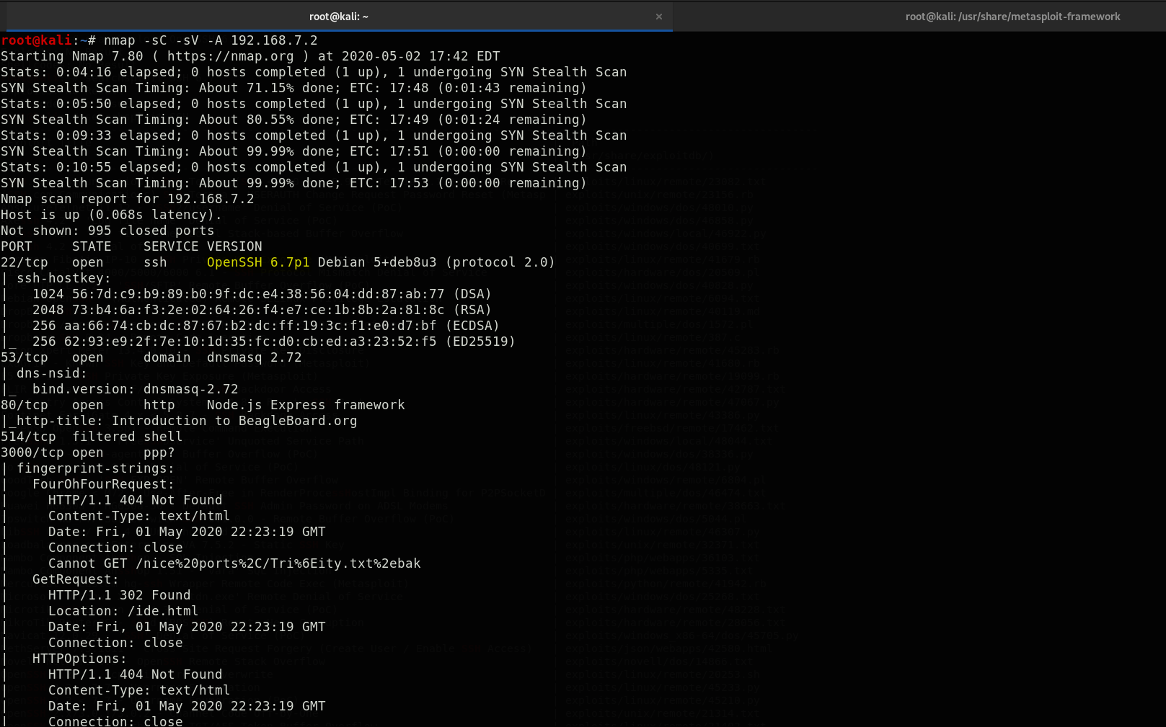
User Enumeration (cont.)

Slide 20
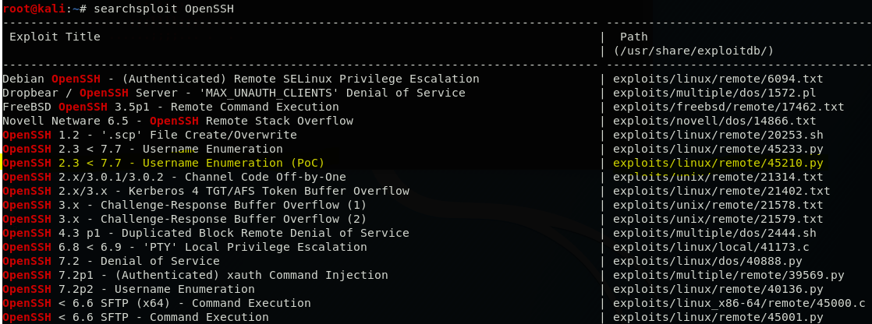
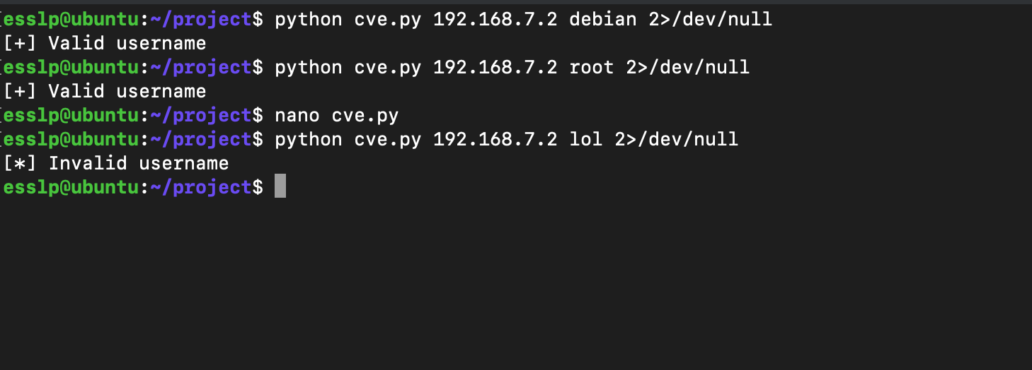
User Enumeration (cont.)

Slide 21
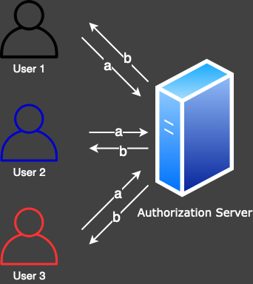
Cloud9 Authentication model
Cloud9, a web-browser based IDE, is deployed in BBB while installation. In it's deployment, the cloud9 utilizes access_token to differentiate among different users.
a: The user requests for access_token from authorization server.
b: The authorization server, issues a valid access_token to each user.

Slide 22
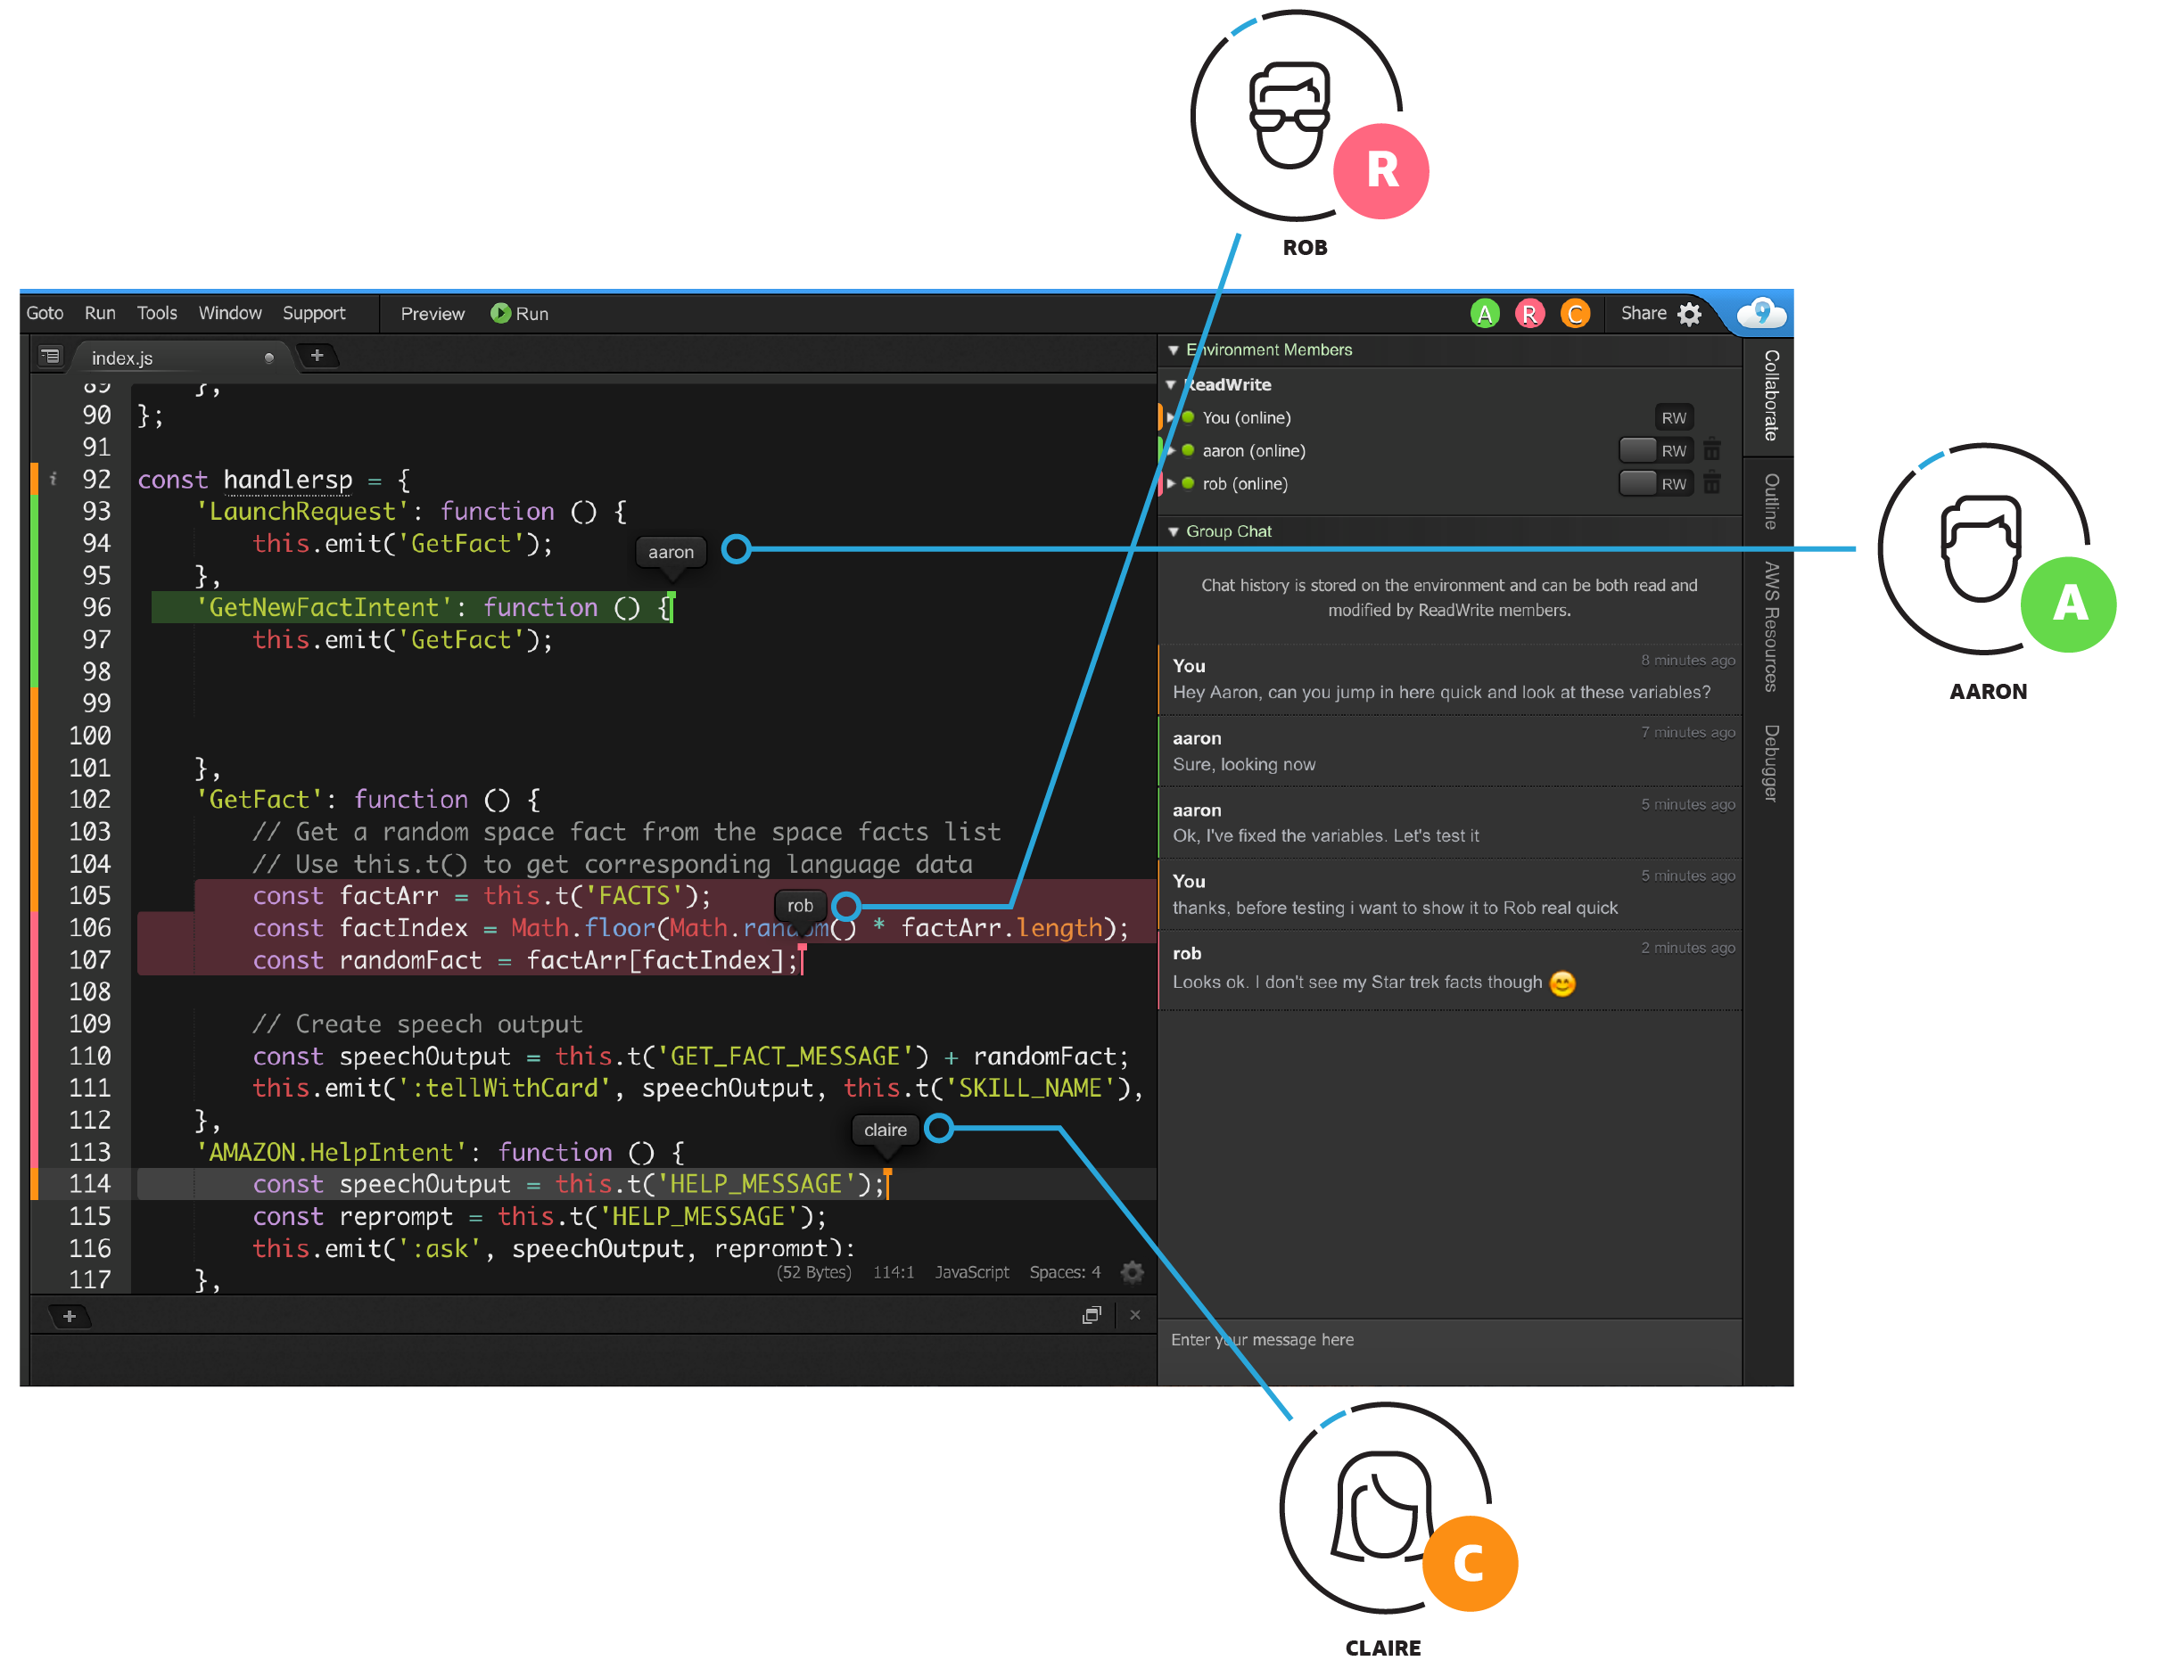
Cloud9 Authentication model
The users are identified by the unique access_token that is issue to them.
Reference: https://d1.awsstatic.com/product-marketing/Tulip/C9-Collab-Image@3x.e03a65d9488633c154358430540ab363dd1e8f45.png

Slide 23
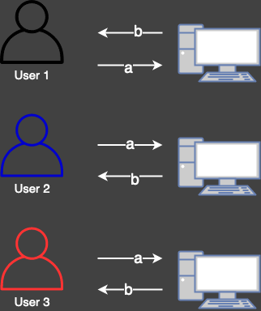
Cloud9 Authentication model
a: The user then request’s for a websocket address using:
POST /vfs/1?access_token=token HTTP/1.1
Host: 129.2.167.52:3000
b: Server returns a valid vfsid with 201 request:
HTTP/1.1 201 Created
Content-Type: application/json
Date: Mon, 04 May 2020 14:32:37 GMT
Connection: close
Content-Length: 78
​
{"pid":1,"uid":-1,"vfsid":"9cnmPaLTnz8q2HBd","activation":{}}

Slide 24
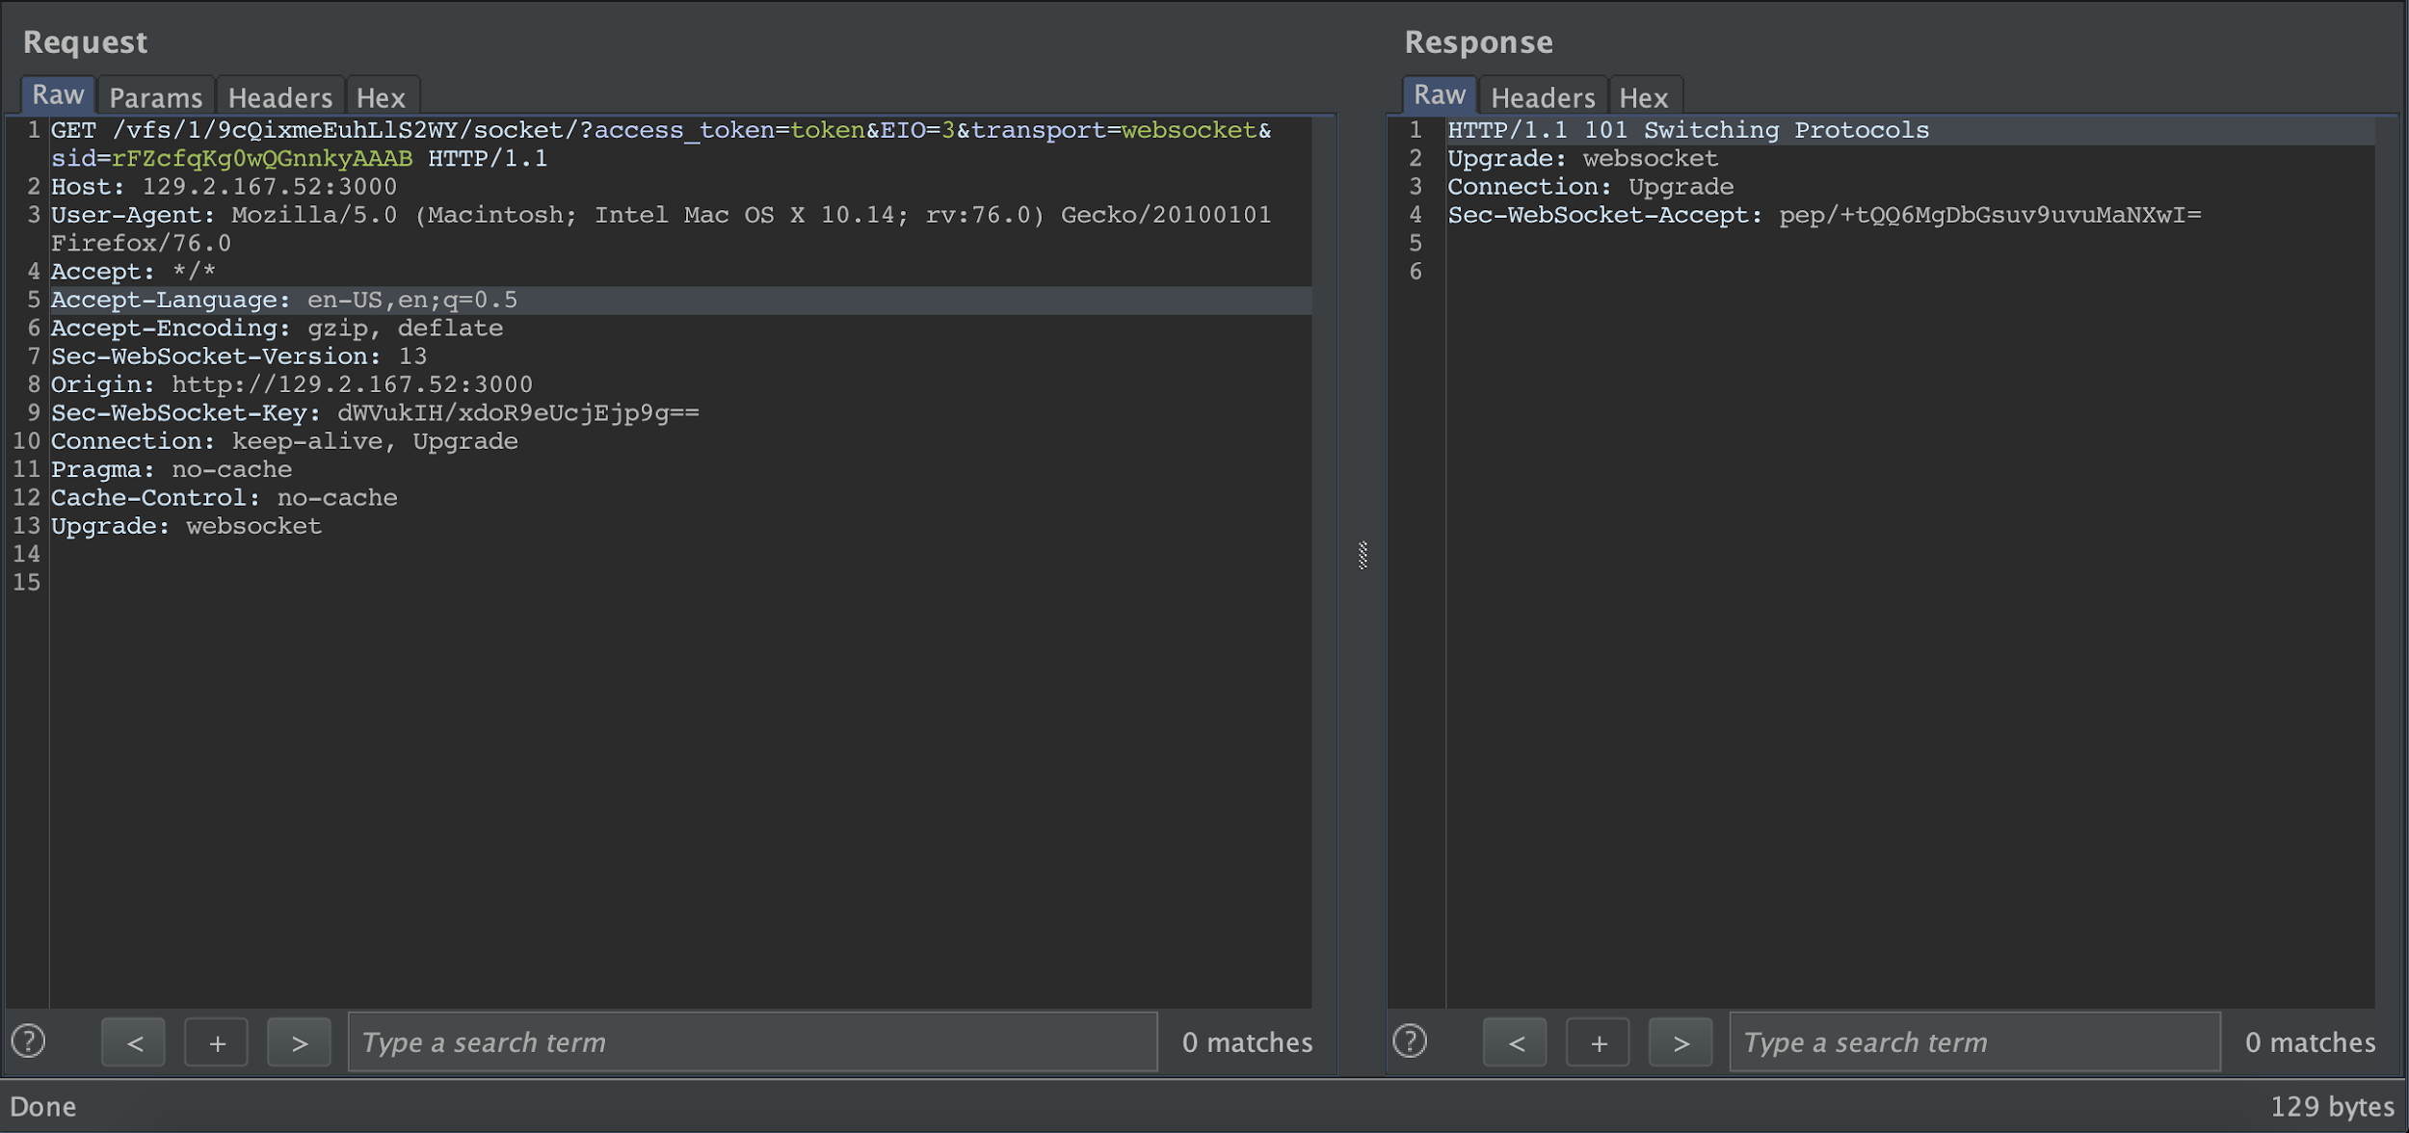
Cloud9 Authentication model
access_token and vfsid exchanged in each request for opening a websocket. And this is where the vulnerability comes!

Slide 25
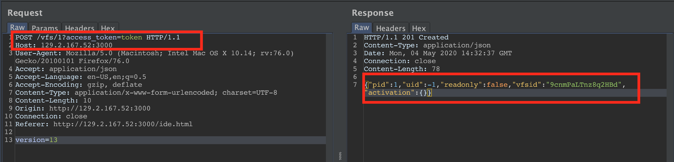
Cloud9 Misconfiguration
The reason is that there is absolutely no authentication and authorization model implemented. All the users are issued the same access_token which is token. So, even though the vfsid is unique for all the users and they are connecting via different sockets, their environments are not different.

Slide 26
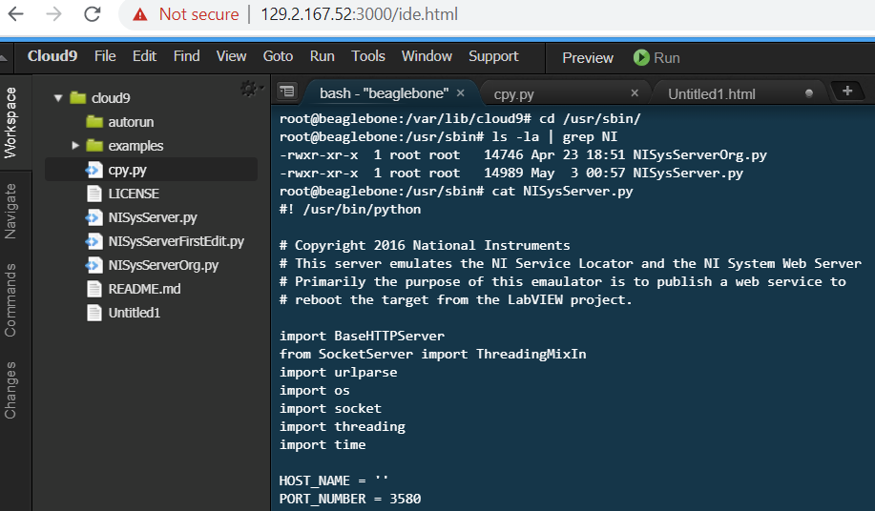

Cloud9 Misconfiguration
This implies that all the users are working in the same environment.
No separation of duties
All users at maximum privilege level “root”.
No authentication framework
An attacker can passively monitor users working on Cloud9

Slide 27
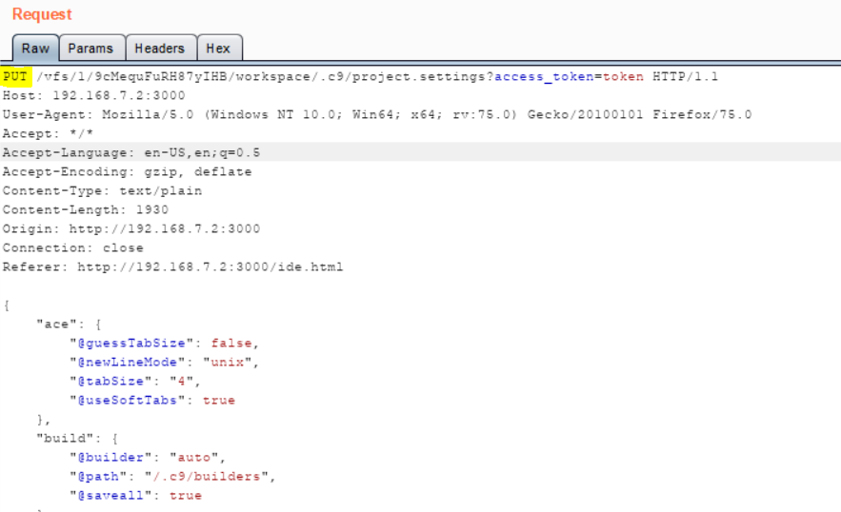
Possible MITM Attack
CLOUD9 - MITM ATTACK:
Request URL reveals Sensitive information like access tokens and vfsid tokens.
Using HTTP to transmit the data.
This vulnerability can be easily leveraged by MITM attacks

Slide 28
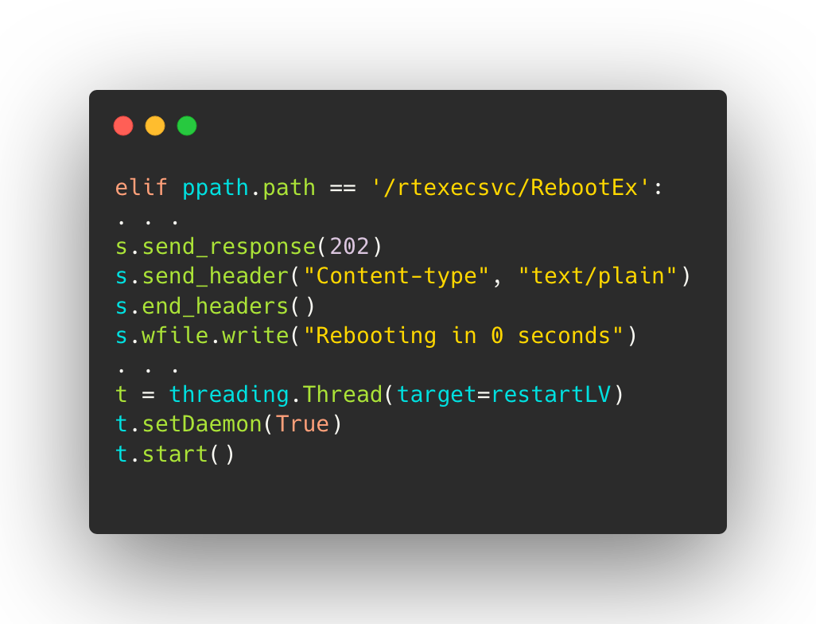
Vulnerabilities in LabVIEW installed Files
NI System Server
The NiSysServer.py script exposes multiple unauthenticated endpoints over port 3580. One of most interesting was /rtexecsvc/RebootEx

Slide 29
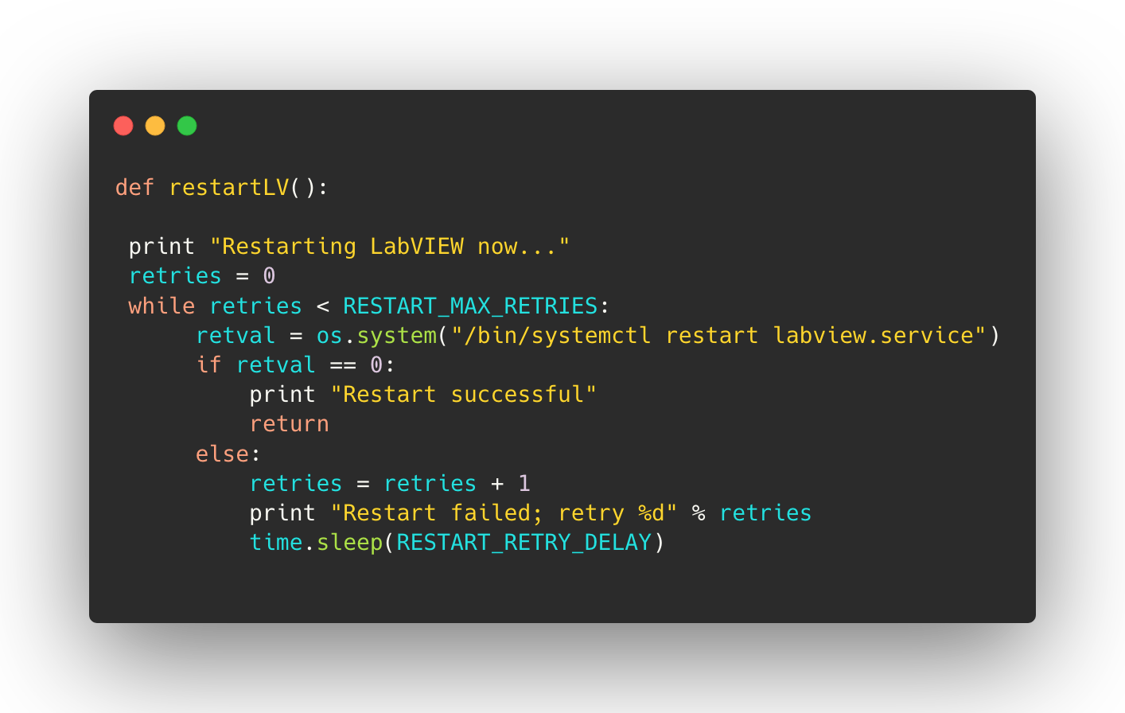
Vulnerabilities in LabVIEW installed Files (cont.)
This endpoint according to the code, would call a function restartLV

Slide 30
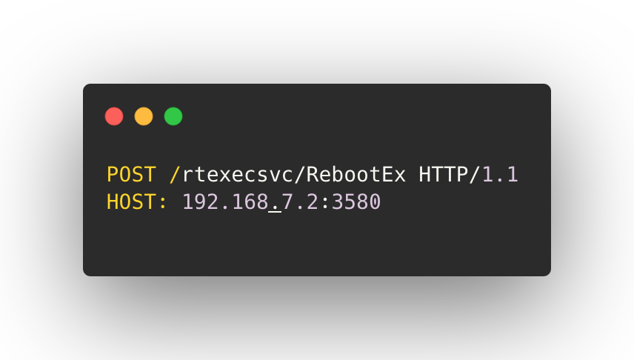
Vulnerabilities in LabVIEW installed Files (cont.)
The os.system() command passes the argument, "/bin/systemctl restart labview.service". Meaning that it is restarting the labview.service.
Therefore, by sending the following POST request, we can effectively restart the service at any time.

Slide 31
Vulnerabilities in LabVIEW installed Files (cont.)
Malicious lvrt-schroot Debian package
Our team modified Labview’s NiSysServer.py file and introduced a new endpoint called /test that is vulnerable to command injection and create a backdoor.
This backdoor is intended to target machines which use LabVIEW dependent applications.
With this backdoor file we constructed a lvrt-schroot debian package which is supposed to act like the lvrt package installed by LabVIEW in our BBB.
We planned to do this attack in two ways
If the target is public facing, we can use the Cloud9 vulnerability identified during reconnaissance of BBB
Compromise the DNS of devices to point to sites of nefarious intent and make them install malicious package instead of the actual “lvrt-schroot.deb”.

Slide 32
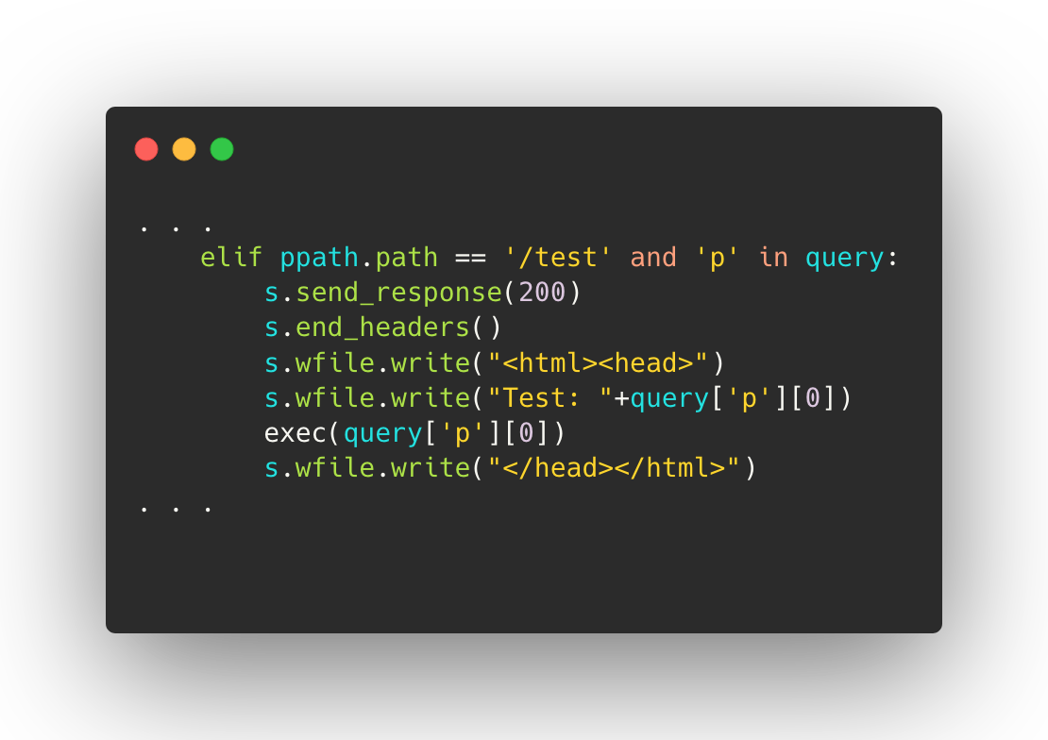
Vulnerabilities in LabVIEW installed Files (cont.)
If the user requests a /test endpoint, the ‘p’ parameter is extracted and is passed to the exec() function.
The exec() function attempts to execute the python code that was passed and can have a dramatic impact on the integrity and availability of the system.
Moreover, the exec() function in Python 2.x is by nature vulnerable to DOS .
A specially crafted payload that gets passed in this script will make it crash impacting the availability of NiSysServer.py.

Slide 33
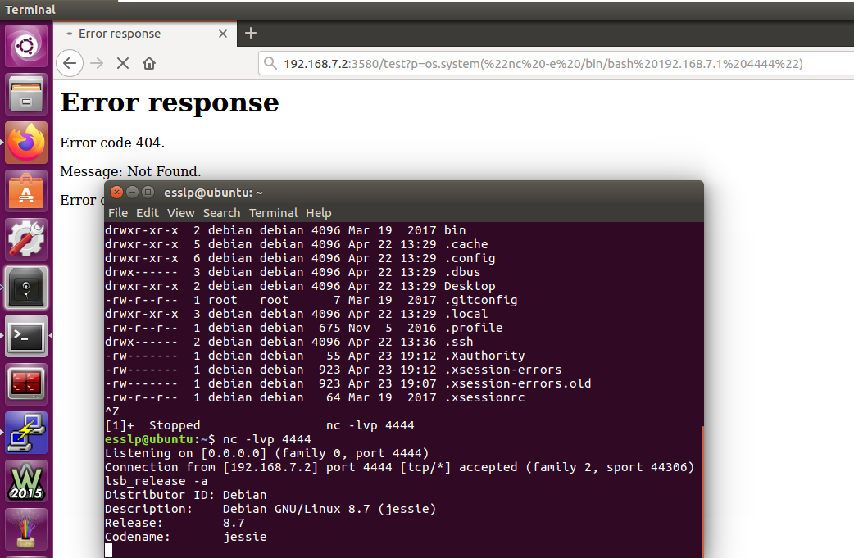
Vulnerabilities in LabVIEW installed Files (cont.)

Slide 34
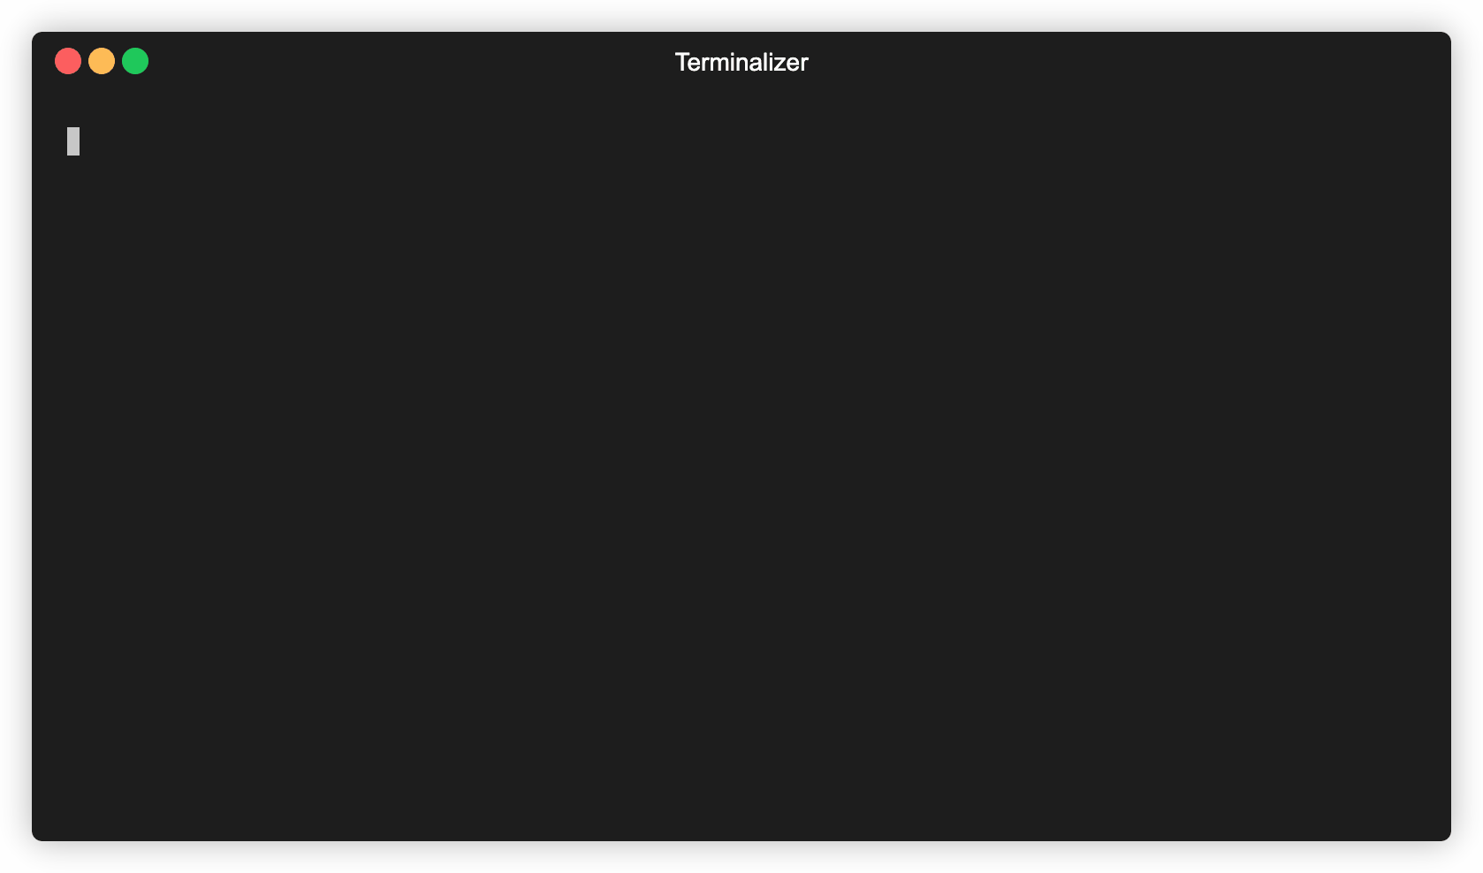
Demo Time

Slide 35
Discover Presence of BBB on a Network
3 Definitive Criterion:
SSH Vulnerable to User enumeration.
Misconfigured Cloud9.
VulnerableNiSysServer.py

Slide 36
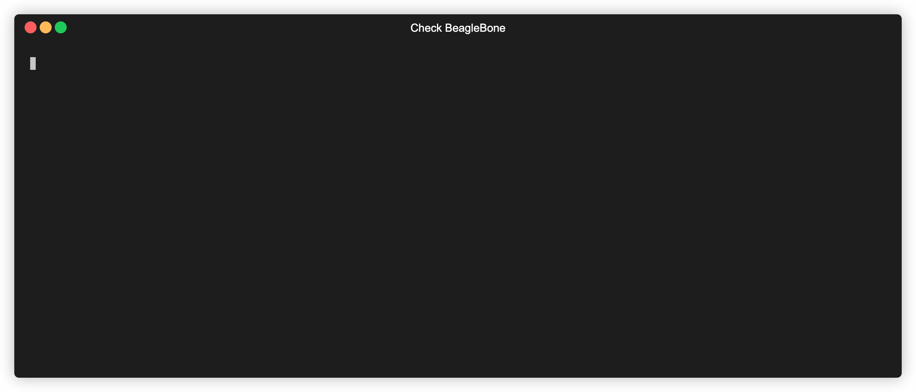
Demo Time

Slide 37
Mitigation Strategies
As it has been explored before, the NiSysServer.py file is deployed separately from the chroot environment. Since the script is exposing the unauthenticated endpoint, it should either be removed or be placed under proper authentication that is setup during the installation of Labview.service.
In order to prevent malicious actors from modifying the NiSysServer.py file, the hash of the file should be validated at the time of boot before invoking the Server. This hash would prevent attackers from modifying the file.
The openssh should be patched to the latest version to prevent malicious actors from enumerating usernames.
Proper authentication should be placed before the cloud9 instance at the time of setup and the user privileges should be downgraded to minimum requirements for the environment. Moreover, some kind of PKI should be deployed on the instance that allows self-signed certificates to be used while interacting with it.

Slide 38

Time for…….

Slide 39




